Slide 1
Newton vs. Leibniz on Space

Slide 2
Topics
Newton’s Conception of Absolute Space
Leibniz’s Relationism
Absolute Acceleration, Inertia Force, & Newton’s Rotating Arguments
Objections & Developments

Slide 3
Newton’s Conception of Absolute Space
Newton’s Principia
What Is Absolute Space?
Relative & Absolute Motion

Slide 4
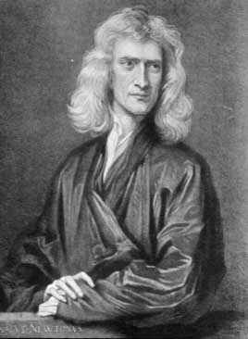
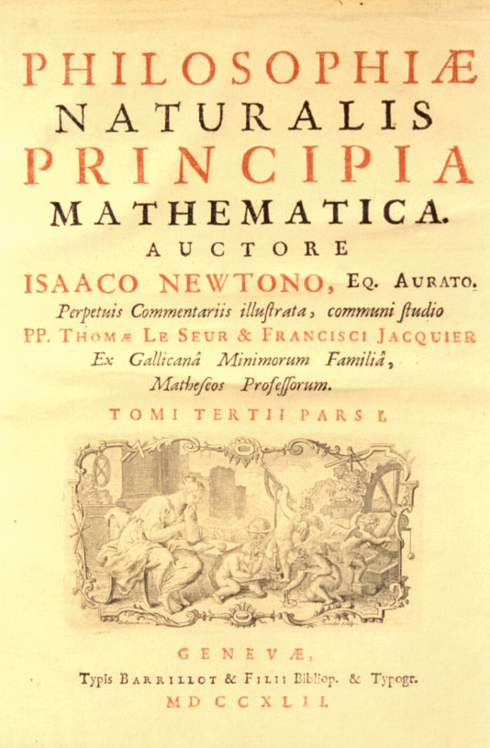
Newton’s Principia
Issac Newton (1643-1727)

Slide 5

What Is Absolute Space?
Infinite, unchanging, 3-dimensional “box”
Existing as a substance independently of material objects and the spatial relations among them.
∞
∞

Slide 6
Relative & Absolute Motion
Frame of reference for measuring
  Relative position (both magnitude & direction)
  Relative velocity (both magnitude & direction)
  = Rate of change of relative position
Values all depend on the frame under consideration.

Slide 7



z
o
z’
y
x
o’
y’
x’
moving relative to xyz-system

Slide 8

Under Newton’s conception, absolute motion is motion relative to absolute space itself.
t₁
t₂
-∞
+∞
-3
-2
-1
0
1
2
3
4
absolute positions of absolute space

Slide 9
Leibniz’s Relationism
Clarke - Leibniz Correspondence
Leibniz’s Relationist Conception of
Space
Leibniz’s Shift Arguments

Slide 10
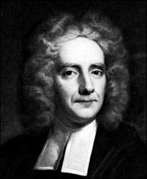
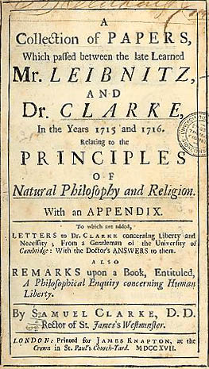
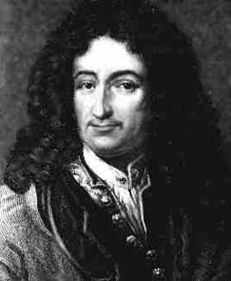
Clarke - Leibniz Correspondence
Samuel Clarke
(1675-1729)
Gottfried Leibniz
(1646-1716)

Slide 11
Leibniz’s Relationist Conception of Space
  Space consists simply of the totality of spatial-relations among material objects.
  Relational (or relative) space is “an order of coexistences” or a “situation of bodies among themselves”.
Absolutely nothing
Matter & Space

Slide 12
Leibniz’s Shift Arguments
Leibniz as a major continental rationalist
  Euclid’s axiomatic systematization of geometry
Principle of Sufficient Reason (PSR)
  “there ought to be some sufficient reason why things should be so, and not otherwise”
  God does things with sufficient reasons.
Principle of the Identity of Indiscernibles (PII)
  “to suppose two things indiscernible, is to suppose the same thing under two names”

Slide 13
The static shift argument:
Universe One
Universe Two
Different absolute locations

Slide 14
Newton’s theory of absolute space
  The two universes are not identical although different absolute locations are indiscernible.
∞
∞
∞
∞

Slide 15
Conflict with PSR:
  No sufficient reason to prefer one of them.
  But should PSR be accepted?
    The nature of God?
    What about construed as “everything has a cause”?
Conflict with PII:
  PII: Since the “two universes” are indiscernible, they are identical.
  But should PII be accepted?
    Related to empiricist criterion of meaningfulness

Slide 16
The kinematic shift argument:
Universe One
Universe Two
Constant absolute velocities

Slide 17
Newton’s theory of absolute space
  The two universes are not identical although different constant absolute velocities are indiscernible.
Conflict with PSR:
  No sufficient reason to prefer one of them.
Conflict with PII:
  PII: Since the “two universes” are indiscernible, they are identical.

Slide 18
Absolute Acceleration,
Inertia Force, & Newton’s Rotating Arguments
Absolute Acceleration &
Inertia Force
Newton’s Rotating Spheres
Newton’s Rotating Bucket

Slide 19
Absolute Acceleration &
Inertia Force
Does the theory of absolute space really have no empirical relevance?
Relative acceleration (both magnitude & direction)
= Rate of change of relative velocity
Absolute acceleration (both magnitude & direction)
= Rate of change of absolute velocity
= Acceleration relative to absolute space
Any empirical interpretation for “absolute acceleration”?

Slide 20


Consider
  Relative accelerations vary with reference frames.
  But the force exerted on the left ball is unique and constant.
Newton’s insight:
  Absolute acceleration is characterized by the presence of inertia force!
a
a

Slide 21



Experiencing inertia forces
F

Slide 22
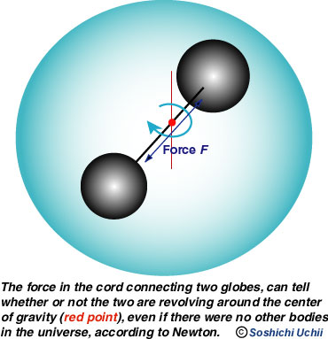
Newton’s Rotating Spheres
Rotation
  Tension in the cord
  Inertia force
How to account for the inertia force?
Is it caused by the rotation of the spheres relative to other things in the universe?

Slide 23
Newton assumed:
  The tension - inertia force - still exists even though the spheres were rotating in an “immense void”.
How to account
for this tension?
Newton concluded:
  Absolute space exerts inertia forces on absolutely accelerating objects.

Slide 24
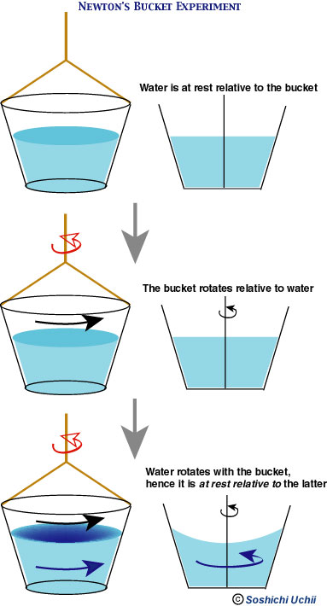
Newton’s Rotating Bucket

Slide 27
Inertia effect
  Concave water surface
Rotation relative to the bucket does not produce the inertia effect.
  Stage 2: relative rotation – yes; inertia effect - no
  Stage 3: relative rotation – no; inertia effect - yes
Similar reasoning leads to the postulation of absolute space and its effect.

Slide 28
Objections & Developments
Leibniz
An Internal Inconsistency
Berkeley & Mach
Absolute Motion without Absolute Space?
Einstein’s Theory of Relativity
Further References
The Short Paper - Reminder

Slide 29
Leibniz
Died during the correspondence.
Did not give a clear response to Newton’s rotating arguments.
Admitted absolute acceleration.
Yet denied that it is related to absolute space, but to whether “the immediate cause of the change is in the body itself”.

Slide 30
An Internal Inconsistency
Newton’s 3rd Law
  For every action, there is an equal and opposite reaction.
Are there any reactions on absolute space?
  Newton’s theory assumes that matter has no effect on absolute space.

Slide 31
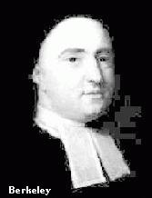
Berkeley & Mach
Berkeley
  Major British empiricist
  Sense experiences as the foundation of knowledge
  Raised some significant objections to Newton’s theory, but did not fully realize the nature of the issue.
1685-1753

Slide 32
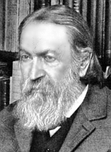
Conceivable?
  Only relative motions among objects make sense.
Mach, 1836-1916

Slide 33


Influences from the distant “fixed stars”
  All influences are derived from relative motions among objects.
Newton found this unacceptable.
  Force from the heavens vs. local interaction with absolute space

Slide 34
Absolute Motion without Absolute Space?
Newton’s assumption:
  All motion has got to be relative to something.
Leibniz’s objection:
  A body is in absolute motion “when the immediate cause of the change is in the body itself”.
Sklar’s idea of absolute motion as a “brute fact” of the object
  Cf. Sklar, L. (1974). Space, Time, and Spacetime.

Slide 35
Einstein’s Theory of Relativity
Dynamical conception of spacetime dissolved the inconsistency.
Einstein’s theory is only partly Machian.
  It requires an absolute standard of constant motion.
  Is this absolute space? – Still debating.
Arguments related to modern spacetime physics
  E.g. the Hole Argument
  http://plato.stanford.edu/entries/spacetime-holearg/

Slide 36
Further References
Stanford Encyclopedia of Philosophy
  “Newton's views on space, time, and motion”
  - http://plato.stanford.edu/entries/newton-stm/
  “absolute and relational theories of space and motion”
  - Not yet available.

Slide 37
The Short Paper - Reminder
Topics chosen should be related to the three topics covered.
  Approval for the topic required.
Other requirements:
  Typed but not hand-written
  No. of words: 2000 – 2500
  Word count at the end.

Slide 38
Marking Criteria:
  Clarity
  Reasoning & argumentation
  Originality
  Quality!
Submission deadline:
  Still 1st December
  Submitted through email.
Happy writing!

